Slide 1
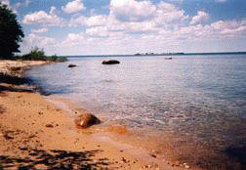
Students Achieving Their Potential
Presented by:
Carolynn Miller
&
Connor Hubbard
An Educational Experience at
Negwegon State Park

Slide 2
Environmental Science Project
Fall 2008 – Phase I of Project
Alcona Community High School Environmental Science Class
Collaboration with Many Organizations
DNR&E
MSU Extension
Michigan Sea Grant
Sprinkler Lake Education Center
High school students wanted to help Negwegon State Park

Slide 3
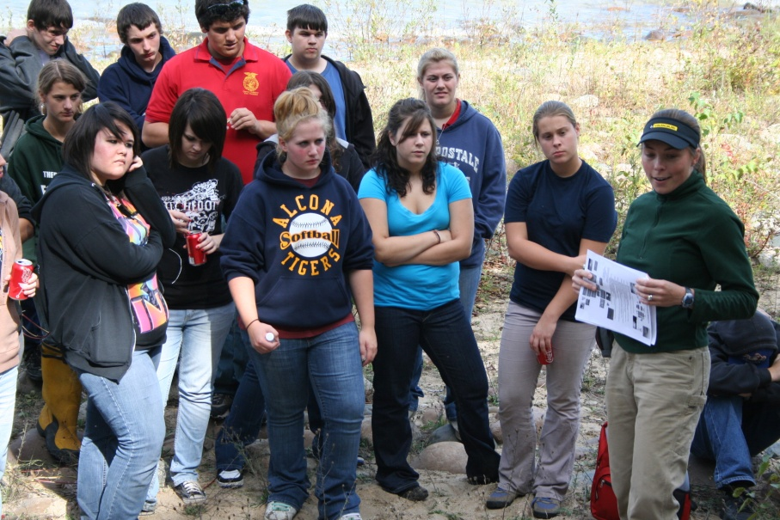
Interpretive Sign Development
Goal:
To develop interpretive signs to inform park visitors about Negwegon State Park.
Class broke into five focus groups
History,
Wildlife Ecosystems,
Forest Ecosystems,
Great Lakes Ecosystems,
Dunes & Soil
Students researched their topics & gathered pictures and information for development of their signs.

Slide 4
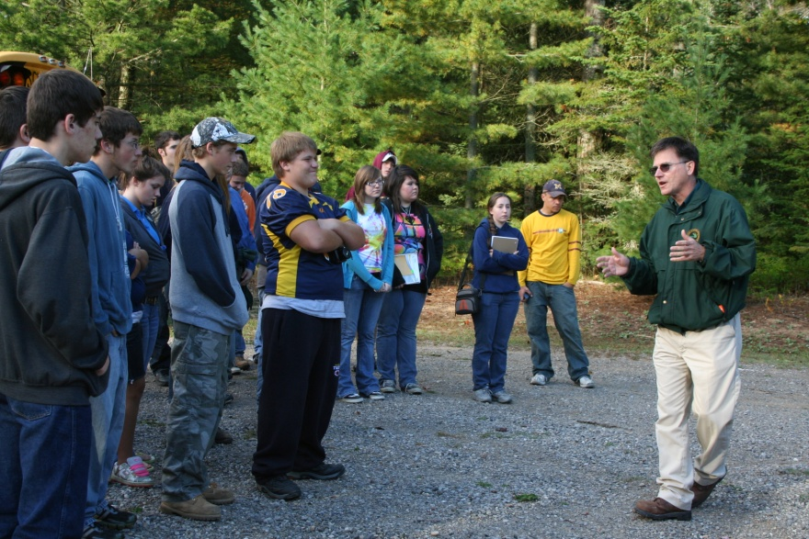
Environmental Science Project
Fall 2009 –
Phase Two of Project
2010 Environmental Science Class
Field trip to park
Continued development of signs

Slide 5
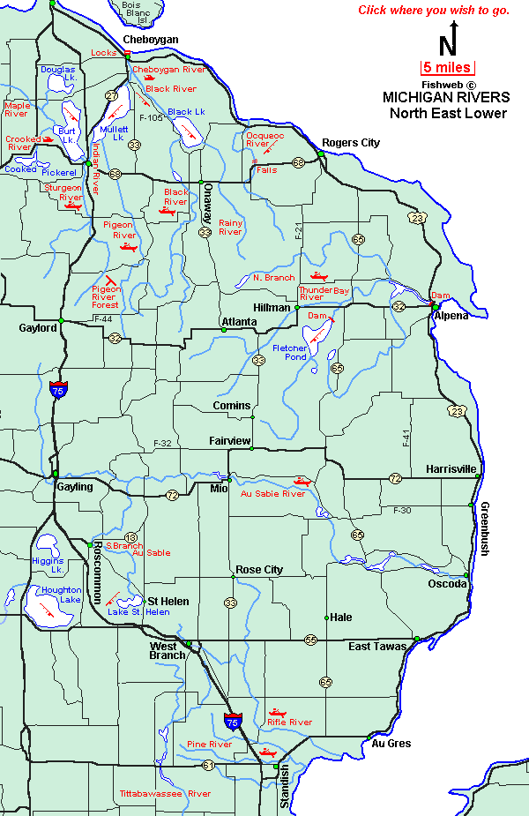
Negwegon State Park
Located on Lake Huron
Rustic, undeveloped area
Open to hunting, fishing, kayaking, and hiking
15 miles of marked hiking trails
Beautiful undeveloped sandy beaches
Open to camping (April through November )
Four designated campsites

Slide 6
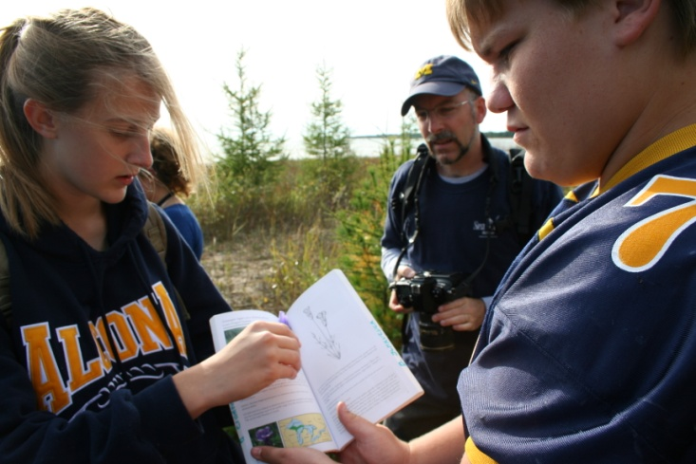
Student Involvement
Involved with community
Gain experience OUTSIDE of the classroom.
Work with natural resource professionals
Learn about professional career opportunities
Present final signs to community members

Slide 7
Students First Draft

Slide 8
Directions
Review sign example #1:
List three animals you think might be found in Negwegon State Park.
Write down two things related to animals you would like to learn about while reading a sign like this.

Slide 9
DNR Edited - Rough Draft of Sign

Slide 10
Directions
Review sign example #2:
Circle two things you learned about animals that you did not know before reading the sign.
How could this sign be improved.

Slide 11
Final Sign – Approved by DNR

Slide 12
Wildlife Ecosystems - Final
What makes this a good interpretive sign?

Slide 13
Funding for Signs
Each sign = ~$1,000 to print
How do we pay for the signs?
$6,000
Great Lakes Stewardship Initiative
$7,000
Michigan Department of Natural Resources and Environment
Total funding = $13,000

Slide 14
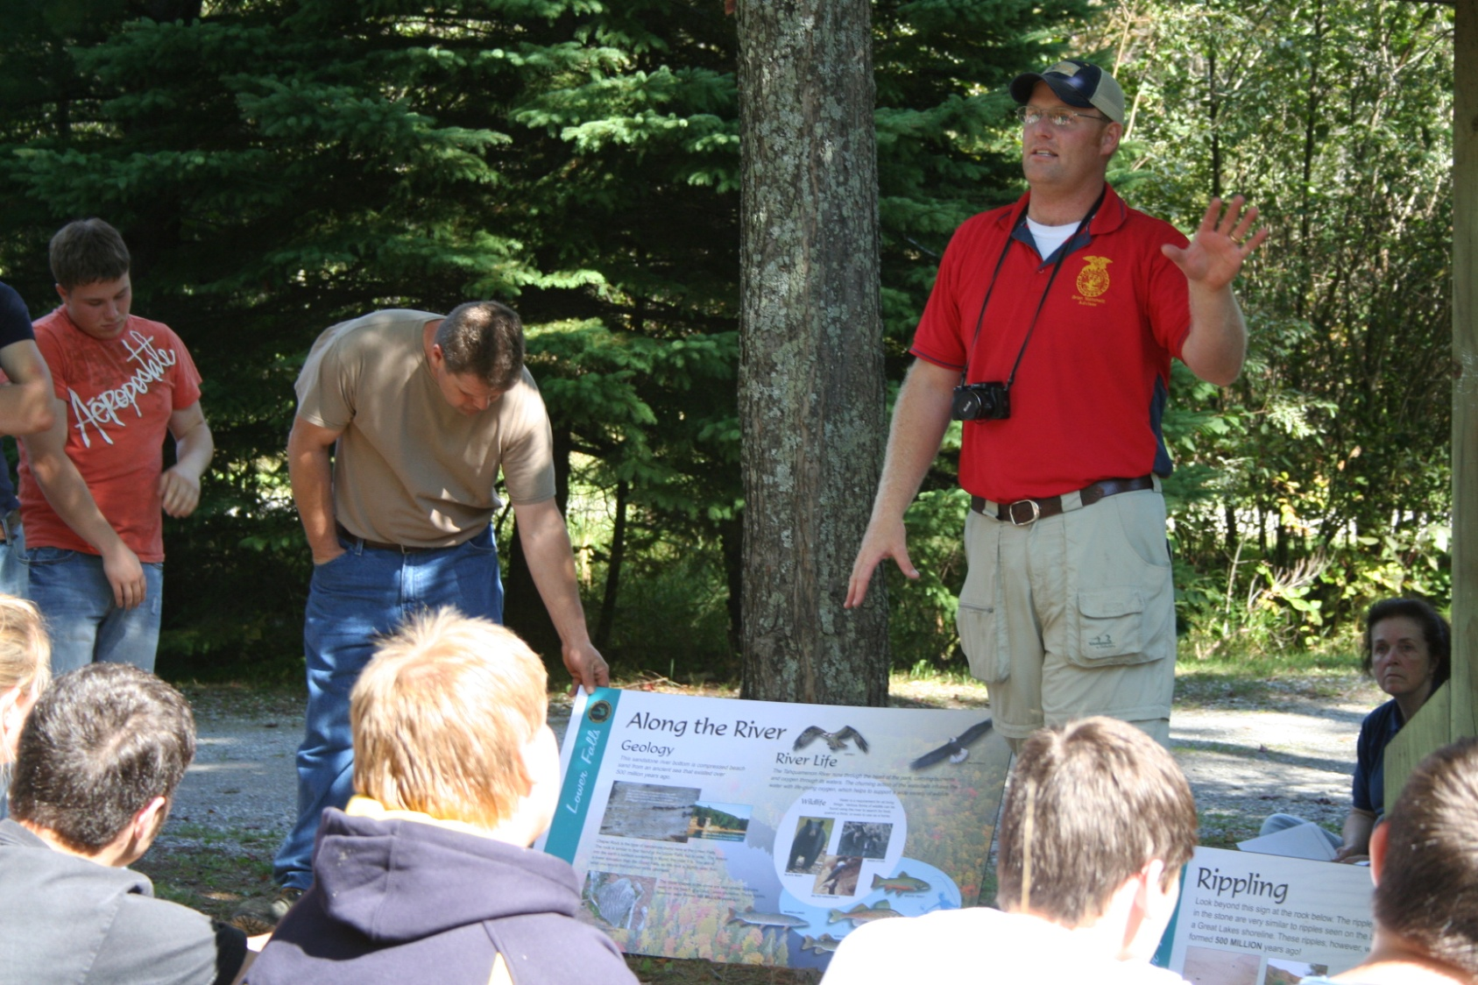
QUESTIONS

